Slide 1
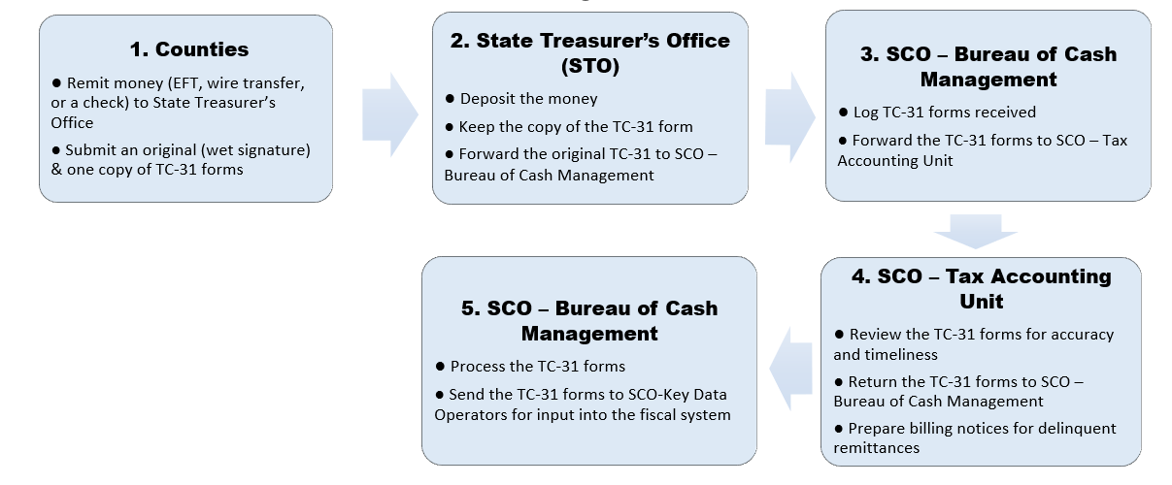
TC-31 Submission Workflow
SCO – Tax Programs Unit
● Receive copies of Audit Report
● Track county payments for audit findings
● Prepare billing notices for interest/penalties related to audit findings

Slide 2
TC-31 Submission Forms
Remittance to the State Treasurer (TC-31) forms can be found on the State Controllers Website LINK
(https://www.sco.ca.gov/Files-ARD-Local/remittc_tc31.xlsx)

Slide 3
TC-31 Submission Website
Trial Court Revenue Distribution Guidelines Page LINK
(https://www.sco.ca.gov/ard_trialcourt_manual_guidelines.html)
New! TC-31 Listserv

Slide 4
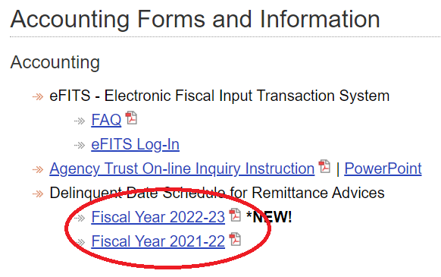
TC-31 Tips 1
Delinquent Date Schedule can be found on the State Accounting Departments section of the State Controller’s Website LINK
(https://www.sco.ca.gov/ard_state_accounting.html)

Slide 5
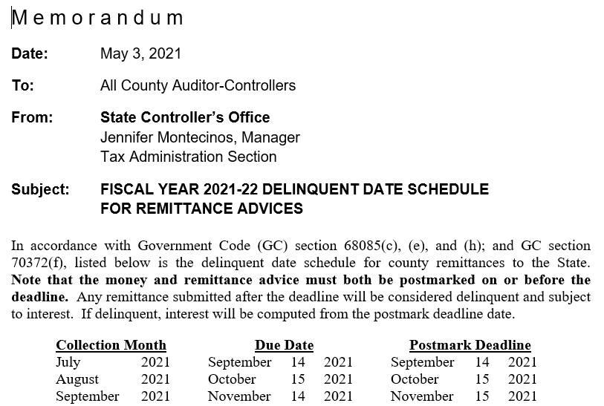
TC-31 Tips 2
Remittances are due 45 days after the end of the month in which they are collected. This is not always the 15th of the month (i.e., remittances for April collections are due by June 14th)

Slide 6
TC-31 Tips 3
Tips to remember when completing your TC-31 forms:
Use a separate Remittance Advice Number for each page of your form, and do not repeat numbers.
Month Name and Number (two digits) should match.
Do not put dollar signs ($) next to the amounts.

Slide 7
TC-31 Tips 4
Monthly TC-31 forms should be dated for the month of collection, not the date of remittance.
TC-31s are based on the fiscal year (July 1–June 30); “2021” is the correct entry for FY 2021-22 collections.

Slide 8
TC-31 Tips 5
Quarterly remittance - Use the last month of the quarter, not the month of the due date.
Ex. January – March 2022 remittances due 4/1/2022.

Slide 9
TC-31 Tips 6
If you are remitting due to an audit finding, please use a separate form. Enter “99” as the month code at the top, enter “Audit” in the Month field, and FY range in the Year.
Enter the prior fiscal year for non-current remittances, such as audit-related payments.
Enter the “Audit Finding number” based on the Audit Summary.

Slide 10
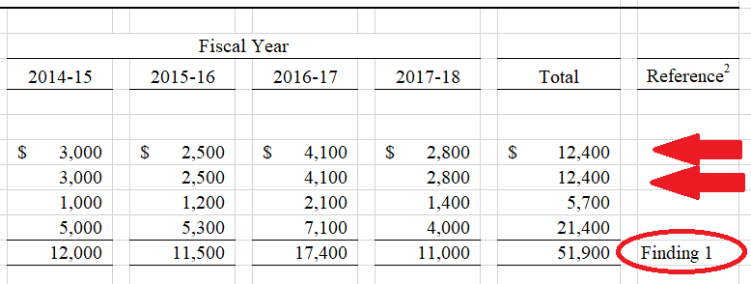
TC-31 Tips 7
Submit a copy of the Summary of Audit Findings schedule with the TC-31 form.

Slide 11
TC-31 Tips 8
Interest/Penalty Remittances
As a result of:
Audit
Delinquent Remittance – Regular Collections
Please submit separately from the regular collections.
Use the TC-31 form sent with the billing letter.
Enter the current fiscal year for all penalty/interest remittances.

Slide 12
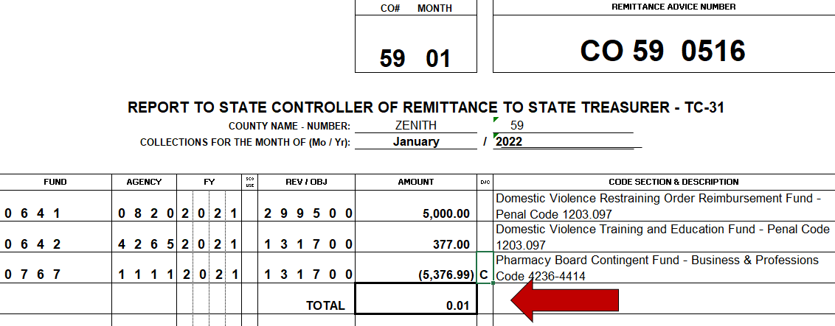
TC-31 Tips 9
The total amount at the bottom of each page must be a positive number.
Negative entries must be submitted with supporting documents.

Slide 13
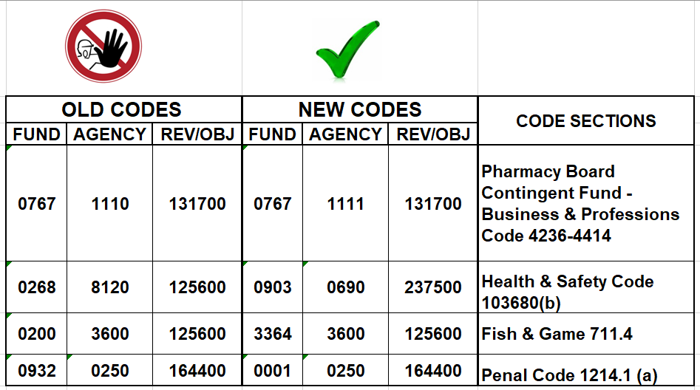
TC-31 Tips 10
Please stop using old/abolished codes and use the new codes.

Slide 14
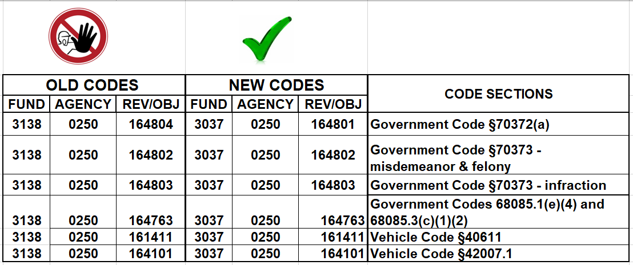
TC-31 Tips 11
Please stop using old/abolished codes and use the new codes.
Court Construction Fund Consolidation
per GC 70371 (b) & (c) - Effective 7/1/2021

Slide 15
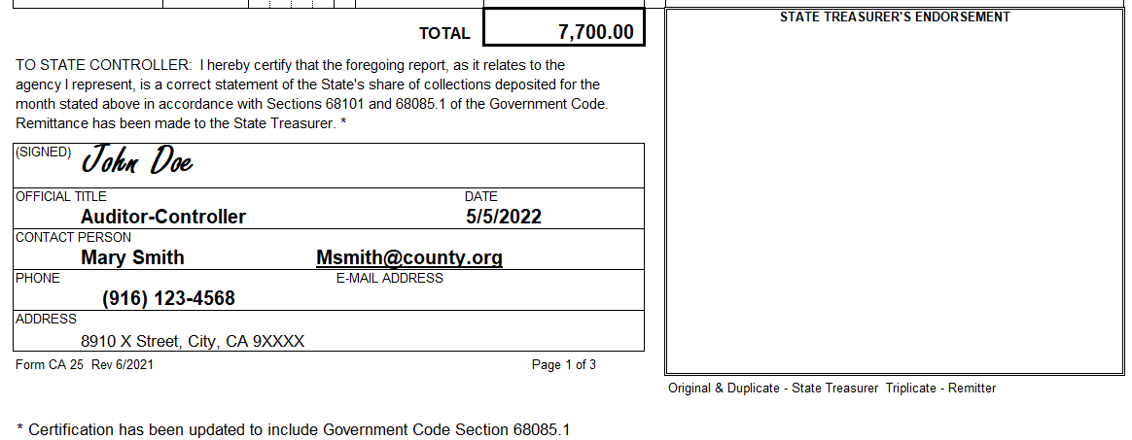
TC-31 Tips 12
Sign and date TC-31 forms. The signature on the TC-31 forms may be an original wet signature, electronic signature, or a signed and scanned copy. Unsigned forms are not processed.
Complete all fields clearly at the bottom of the TC-31 form.

Slide 16
TC-31 Submission Information
Submit your TC-31 forms to:
State Treasurer’s Office
ATTN: CTSMD – Financial Services Section
901 P Street, 2nd Floor, Room 213-B
Sacramento, CA 95814
OR
State Treasurer’s Office
ATTN: CTSMD – Financial Services Section
P.O. Box 942809
Sacramento, CA 94209-0001
DO NOT submit your TC-31 forms to the State Controller’s Office.

Slide 17
TC-31 Contacts
For electronic payment inquiries, please email STO:
CTSMD_In_Out_Wires@treasurer.ca.gov
cc: finserv@treasurer.ca.gov
Tax Accounting Unit:
lgpsdtaxaccounting@sco.ca.gov
Marieta Delfin – MDelfin@sco.ca.gov
Agboo Abeywickrama – AAbeywickrama@sco.ca.gov
Tax Programs Unit (Court Revenue Audit Questions):
lgpsdtaxprograms@sco.ca.gov
Lacey Baysinger – Lbaysinger@sco.ca.gov
Ying Dong – Ydong@sco.ca.gov

