Slide 1
Revenue Distribution Training March 2013
Presented by the
State Controller’s Office
and the
Administrative Office of the Courts
Notes:
Notes:
Self-introduction by opening presenter (keep it short, name and title only)
Introduce AOC and/or SCO Executive Sponsors for opening remarks.

Slide 2
INTRODUCTION
Notes:
Consider removing this slide as not really necessary since opening remarks speakers can be introduced at first slide.
Consider moving housekeeping slide here instead.

Slide 3
Faculty and Contacts
State Controller’s Office:
Jim Reisinger
Darryl Mar
Sandeep Singh
Administrative Office of the Courts:
John Judnick
Robert Cabral
Ryan Mendoza
jreisinger@sco.ca.gov
dmar@sco.ca.gov
sxsingh@sco.ca.gov
john.judnick@jud.ca.gov
robert.cabral@jud.ca.gov
ryan.mendoza@jud.ca.gov
Notes:
Consider moving up faculty slide to after agenda.

Slide 4
BREAKOUT SESSION 1
Parking

Slide 5
Discussion Topics
Parking violations – 1993 revision of parking infractions to admin. offenses
Vehicle Code section 463 - definition of park or parking
Uniform Bail and Penalty Schedule
Page xii regarding Parking Violations
Parking citations and infractions
Certain statute sections cite parking violations as infractions
$3 penalty assessment imposed under GC section 76000.3 on all parking citations including infractions (UB&PS footnotes 41-43 on pages 71 and 72)
Equipment Violations on Parking Citations - VC section 40225(a) – (c) and VC 40303.5
Appendix C and some applicable statutory sections
Distribution spreadsheets:
Regular parking citation (San Francisco example)
Parking Infraction – Parking in Bus Loading Area
Parking Infraction – Equipment Violation

Slide 6
Parking Violations – Administrative Offenses
Assembly Bill 408 (stats. 1992, ch. 1244), effective January 1, 1993, revised and recast the procedures for processing and adjudicating parking law violations as administrative offenses subject to a civil penalty.
The bill required courts to transfer the processing of parking offenses to issuing agencies not later than January 1, 1994.
Consequently, parking violations that cannot be cited as infractions have been removed from the Uniform Bail and Penalty Schedules.

Slide 7
Parking Defined – VC 463
VC 463 defines “park or parking” as:
“the standing of a vehicle, whether occupied or not, otherwise than temporarily for the purpose of and while actually engaged in the loading or unloading of merchandise or passengers.”

Slide 8
Uniform Bail and Penalty Schedule (UB&PS)
Traffic Infraction Fixed Penalty Schedule (TIFPS) of the UB&PS includes Vehicle Code sections that may be cited for a stopping violation on a notice to appear that is signed by the driver.
See page xii of the UB&PS regarding Parking Violations.

Slide 9
Parking Offenses Under Gov. Code 76000.3
76000.3 (a) Notwithstanding any other law, for each parking offense where a parking penalty, fine, or forfeiture is imposed, an added penalty of three dollars ($3) shall be imposed in addition to the penalty, fine, or forfeiture set by the city, district, or other issuing agency.
The above applies to all parking offenses including infractions covered under subdivision (b).

Slide 10
Parking Violation Infractions Gov. Code 76000.3(b)
Under Government Code section 76000.3(b), a $3 penalty assessment is imposed on every fine for a parking infraction violation committed on or after January 1, 2011.
DISTRIBUTION: The county treasurer shall transmit the penalty imposed pursuant to subdivision (a) to the Treasurer for deposit in the Trial Court Trust Fund established under Section 68085.

Slide 11
Government Code Section 76000.3(b)
(b) For each infraction parking violation for which a penalty or fine is collected in the courts of the county, the county treasurer shall transmit the penalty imposed pursuant to subdivision (a) to the Treasurer for deposit in the Trial Court Trust Fund established by Section 68085.
These moneys shall be taken from the penalties, fines, and forfeitures deposited with the county treasurer prior to any division pursuant to Section 1463.009 of the Penal Code. The judges of the county shall increase the bail schedule amounts as appropriate for infraction parking violations to reflect the added penalty provided for by subdivision (a).

Slide 12
Government Code Section 76000.3(c)
c) In those cities, districts, or other issuing agencies which elect to accept parking penalties, and otherwise process parking violations pursuant to Article 3 (commencing with Section 40200) of Chapter 1 of Division 17 of the Vehicle Code, that city, district, or issuing agency shall collect the added penalty imposed by this section. Each agency that elects to process parking violations shall pay to the Treasurer for deposit in the Trial Court Trust Fund three dollars ($3) for each civil parking penalty collected on each violation. Those payments to the Treasurer shall be made monthly.

Slide 13
Parking Infraction Violation Examples
Under VC section 42001.13, a violation of disabled parking provisions in Vehicle Code section 22507.8 may be cited as an infraction on a notice to appear.
42001.13 (a) A person who commits a violation of Section 22507.8 is subject to either a civil notice of parking violation pursuant to Article 3 (commencing with Section 40200) of Chapter 1 of Division 17 or a criminal notice to appear.
(b) If a notice to appear is issued and upon conviction of an infraction for a violation of Section 22507.8, a person shall be punished as follows: (1) A fine of not less than two hundred fifty dollars ($250) and not more than five hundred dollars ($500) for the first offense. (2) A fine of not less than five hundred dollars ($500) and not more than seven hundred fifty dollars ($750) for the second offense. (3) A fine of not less than seven hundred fifty dollars ($750) and not more than one thousand dollars ($1,000) for three or more offenses.
(c) The court may suspend the imposition of the fine if the person convicted possessed at the time of the offense, but failed to display, a valid special identification license plate issued pursuant to Section 5007 or a distinguishing placard issued pursuant to Section 22511.55 or 22511.59. (d) A fine imposed under this section may be paid in installments if the court determines that the defendant is unable to pay the entire amount in one payment.

Slide 14
Parking Infraction Violation Examples
Under VC section 42001.5, a violation of Vehicle Code sections 22500(i), 22500(l), and 22522 may be cited as an infraction on a notice to appear.
42001.5 (a) A person convicted of an infraction for a violation of subdivision (i) or (l) of Section 22500, or of Section 22522, shall be punished by a fine of not less than two hundred fifty dollars ($250). (b) No part of any fine imposed under this section may be suspended, except the court may suspend that portion of the fine above one hundred dollars ($100). (c) A fine imposed under this section may be paid in installments if the court determines that the defendant is unable to pay the entire amount in one payment.

Slide 15
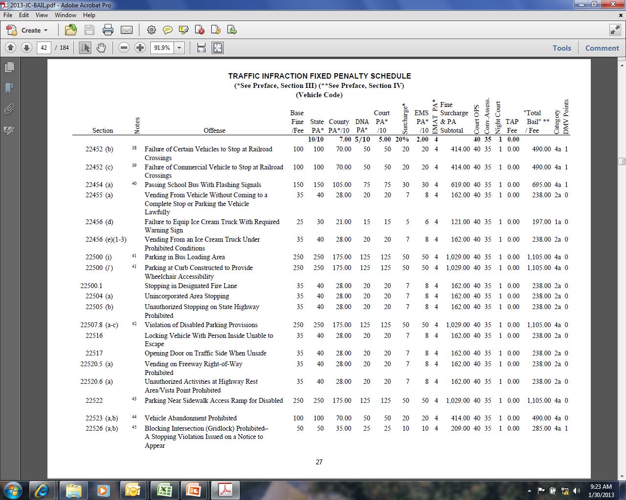

Slide 16
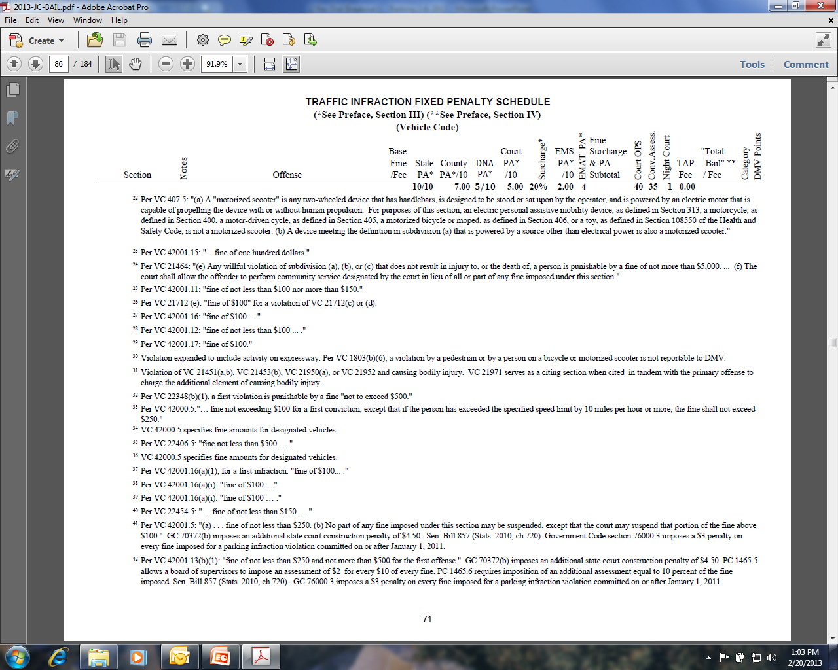

Slide 17
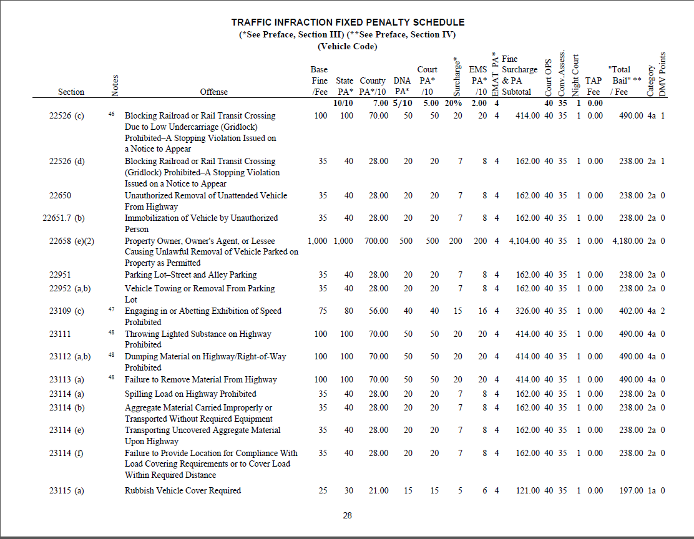

Slide 18
Equipment Violations on Parking Citations
Under VC 40225(a), equipment violations entered on a notice of parking violation are subject to a civil penalty established according to VC 40225(c).
VC 40225.
(a) An equipment violation entered on the notice of parking violation attached to the vehicle under Section 40203 shall be processed in accordance with this article. All of the violations entered on the notice of parking violation shall be noticed in the notice of delinquent parking violation delivered pursuant to Section 40206, together with the amount of civil penalty.
(b) Whether or not a vehicle is in violation of any regulation governing the standing or parking of a vehicle but is in violation of subdivision (a) of Section 5204, a person authorized to enforce parking laws and regulations shall issue a written notice of parking violation, setting forth the alleged violation. The violation shall be processed pursuant to this section.

Slide 19
Vehicle Code Section 40225(c)
The civil penalty for each equipment violation, including failure to properly display a license plate, is the amount established for the violation in the Uniform Bail and Penalty Schedule, as adopted by the Judicial Council,
except that upon proof of the correction to the processing agency, the penalty shall be reduced to ten dollars ($10).
Applicable examples: VC 5200, VC 5201, VC 5204, and VC 5206.

Slide 20
Vehicle Code 40225(c) “Compliance Fee” of $10
The reduction provided for in this subdivision involving failure to properly display license plates shall only apply if, at the time of the violation, valid license plates were issued for that vehicle in accordance with this code.
The civil penalty for each equipment violation is the amount established for the violation in the Uniform Bail and Penalty Schedule, as adopted by the Judicial Council, except that upon proof of the correction to the processing agency, the penalty shall be reduced to ten dollars ($10).

Slide 21
Vehicle Code Section 40225(d)
(d) Fifty percent of any penalty collected pursuant to this section for registration or equipment violations by a processing agency shall be paid to the county for remittance to the State Treasurer and the remaining 50 percent shall be retained by the issuing agency and processing agency subject to the terms of the contract described in Section 40200.5.

Slide 22
Offenses Eligible for Correction
VC 40303.5: Whenever any person is arrested for any of the following offenses, the arresting officer shall permit the arrested person to execute a notice containing a promise to correct the violation in accordance with the provisions of Section 40610 unless the arresting officer finds that any of the disqualifying conditions specified in subdivision (b) of Section 40610 exist . . .
Refer to page xi of the UB&PS.

Slide 23
Parking Violations Statutes and Appendix C
GC 76000 (b), (c), and (d)
An additional penalty of $2.50 for every parking penalty, fine, or forfeiture imposed. See Appendix C
(b) In each authorized county, provided that the board of supervisors has adopted a resolution stating that the implementation of this subdivision is necessary to the county for the purposes authorized, with respect to each authorized fund established pursuant to Section 76100 or 76101, for every parking offense where a parking penalty, fine, or forfeiture is imposed, an added penalty of two dollars and fifty cents ($2.50) shall be included in the total penalty, fine, or forfeiture. Except as provided in subdivision (c), for each parking case collected in the courts of the county, the county treasurer shall place in each authorized fund two dollars and fifty cents ($2.50).

Slide 24
Gov Code 76000(c) and (d)
(c) The county treasurer shall deposit one dollar ($1) of every two dollars and fifty cents ($2.50) collected pursuant to subdivision (b) into the general fund of the county.
(d) The authority to impose the two-dollar-and-fifty-cent ($2.50) penalty authorized by subdivision (b) shall be reduced to one dollar ($1) as of the date of transfer of responsibility for facilities from the county to the Judicial Council pursuant to Article 3 (commencing with Section 70321) of Chapter 5.1, except as money is needed to pay for construction provided for in Section 76100 and undertaken prior to the transfer of responsibility for facilities from the county to the Judicial Council.

Slide 25
Parking Violations Statutes and Appendix C
GC 70372(b) imposes an additional assessment of $4.50 on each parking penalty, fine, or forfeiture (violation infraction conviction):
State Court Construction Penalty. See Appendix C
100% distribution to State (2/3 to ICNA and 1/3 to State Court Facilities Construction Fund). See Appendix C

Slide 26
Parking Violations Statutes and Appendix C
GC 76000.3 imposes a $3 penalty on every fine imposed for a parking infraction violation committed on or after January 1, 2011:
Trial Court Trust Fund Parking Penalty, See Appendix C
Distribution to the State Trial Court Trust fund established by GC 68085
Effective until July 1, 2013 (Sunset has been removed)

Slide 27
Parking Violations Statutes and Appendix C
GC 70373 requires a criminal conviction assessment of $35:
Criminal Conviction Assessment. See Appendix C
100% distribution to State (ICNA fund GC 70371.5). See Appendix C

Slide 28
Distribution Spreadsheets
Disclaimer: All spreadsheets have been updated to reflect what we believe are the statutes in effect as of TODAY. Thus, they are subject to change based on laws that are effective subsequent to today’s training. When using the spreadsheets, be sure the fines, penalties, and fees reflect the statutes in effect for the period being reviewed.

Slide 32
BREAKOUT SESSION 1 Recap
Covered the Following:
Parking violations – 1993 revision of parking infractions to administrative offenses
Vehicle Code section 463 - definition of “parking”
Uniform Bail and Penalty Schedule – parking infractions
Parking Offense Citations Under GC 76000.3(a) and (c)
Parking Infractions Under GC 76000(b)
Equipment Violations on Parking Citations
VC 40225(a) – (c)
VC 40303.5
SCO Appendix C - some applicable statutory sections
8. Parking Distribution Examples

Slide 33
BREAKOUT SESSION 1
Parking
QUESTIONS?

Slide 34
END OF BREAKOUT SESSION 1
Parking

